Slide 1
Reading Group
Presenters: Siyi Du, Shaoming Zheng
Supervisor: Dr. Chen Qin
2024-05-09

Slide 2
Content
1. The Problem with Transformers
Transformers in NLP
Are RNNs a solution?
2. Mamba
State Space Model (SSM)
Mamba
3. Vision Mamba
Motivation
Methodology
Experiments

Slide 3
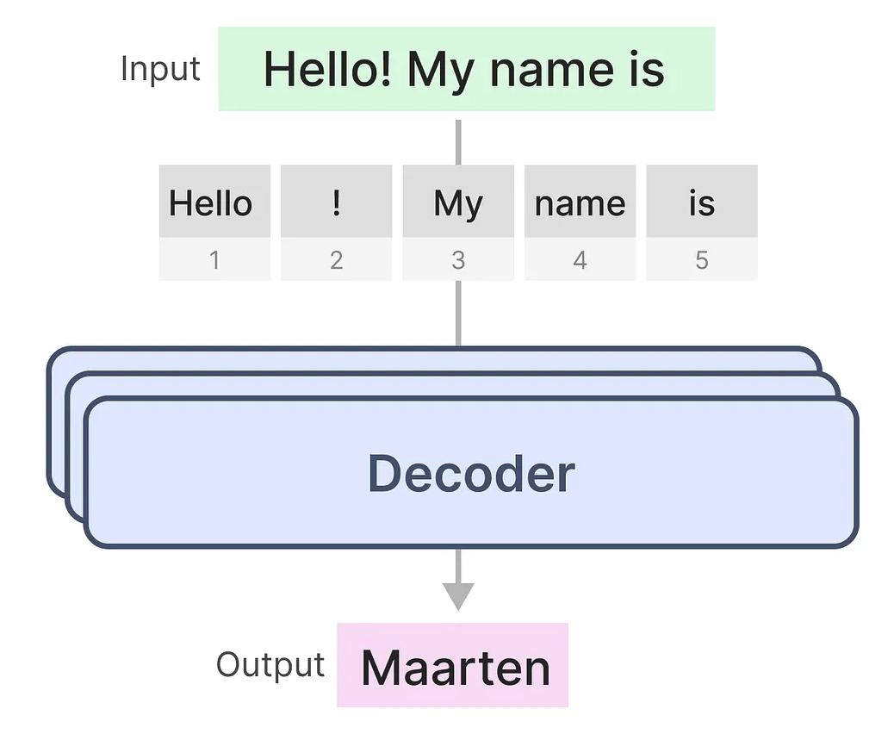
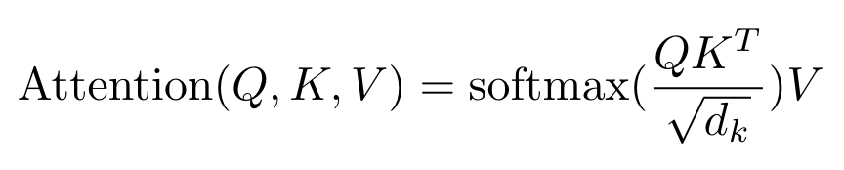
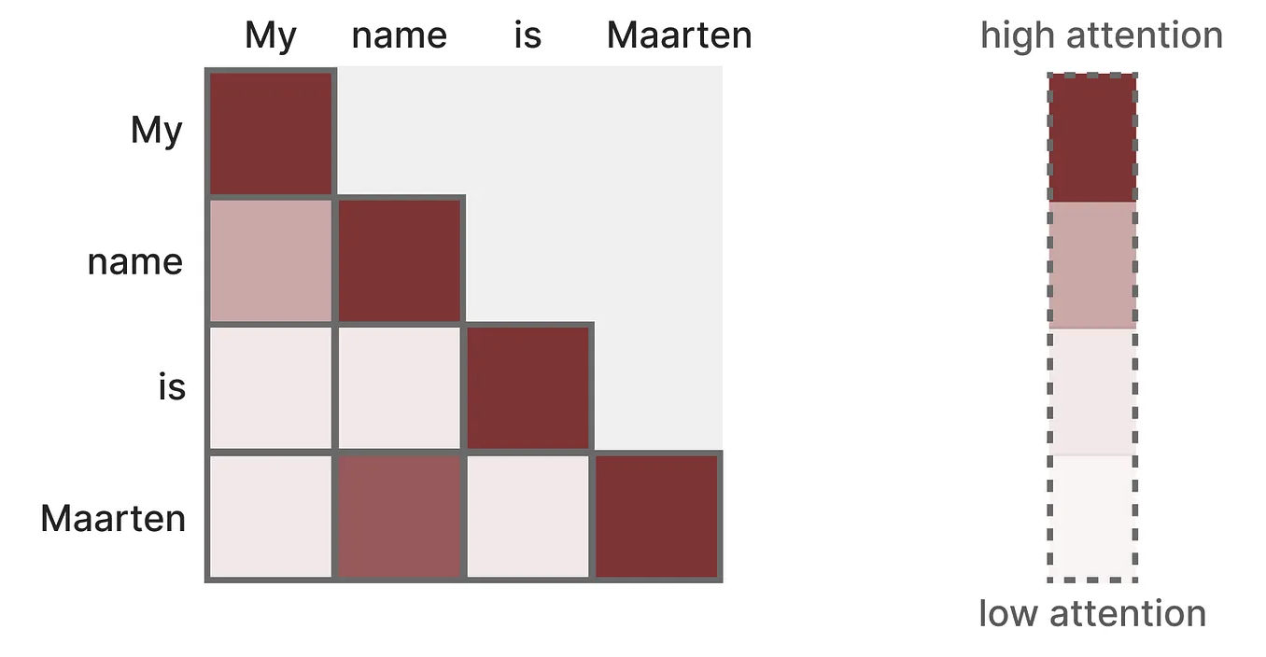
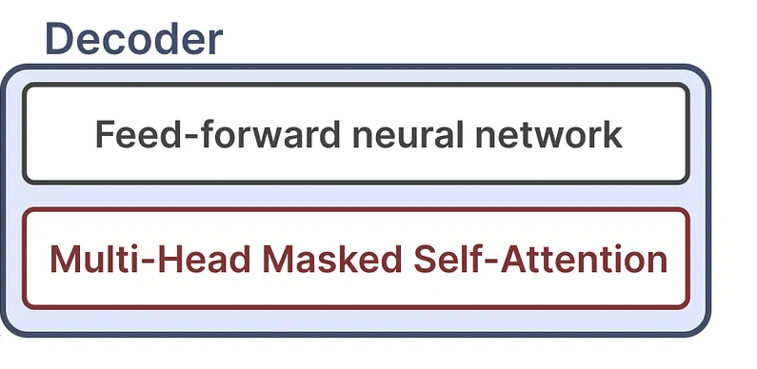
Recap of Transformers
The key component of transformers is attention
Calculate the attention map at once in training (fast)
Figures: https://newsletter.maartengrootendorst.com/p/a-visual-guide-to-mamba-and-state

Slide 4
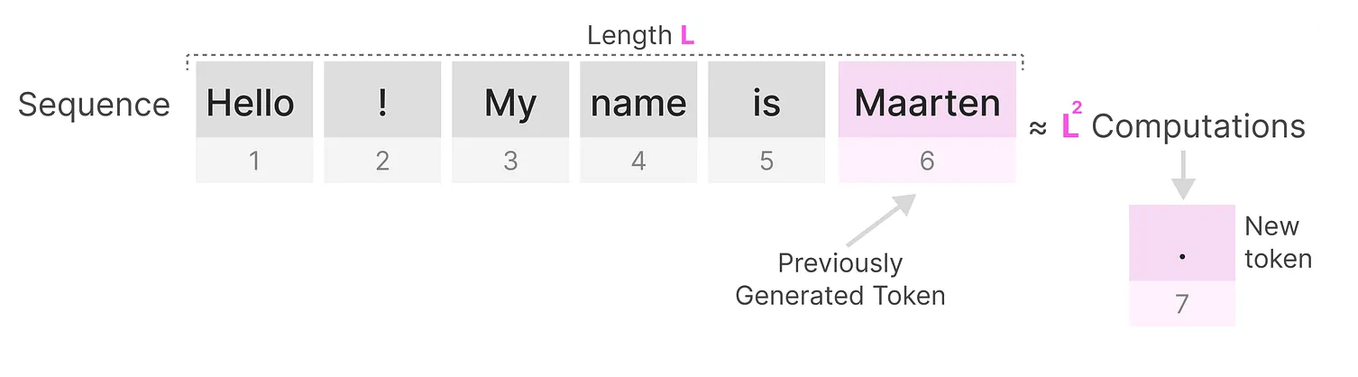
Problems with Transformers
Slow inference
Large memory usage
Figures: https://newsletter.maartengrootendorst.com/p/a-visual-guide-to-mamba-and-state

Slide 5
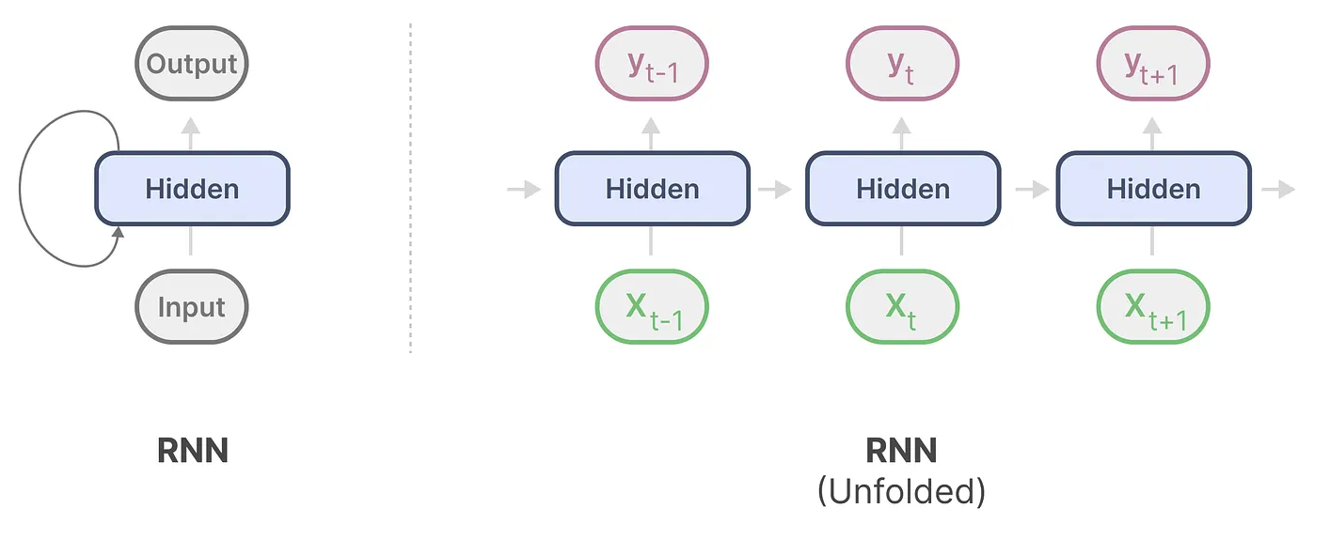
RNNs
Fast inference
Slow training (non parallelizable)
Figures: https://newsletter.maartengrootendorst.com/p/a-visual-guide-to-mamba-and-state

Slide 6
State Space Model (SSM)
Model | Training | Inference | Memory
Transformers | Fast (parallelizable) | Slow (quadratically to sequence length) | Large (attention map scale to sequence length)
RNNs | Slow (Non parallelizable) | Fast (Constant) | Small (Constant)
SSMs | Fast (convolution) | Fast (Constant) | Small (Constant)

Slide 7
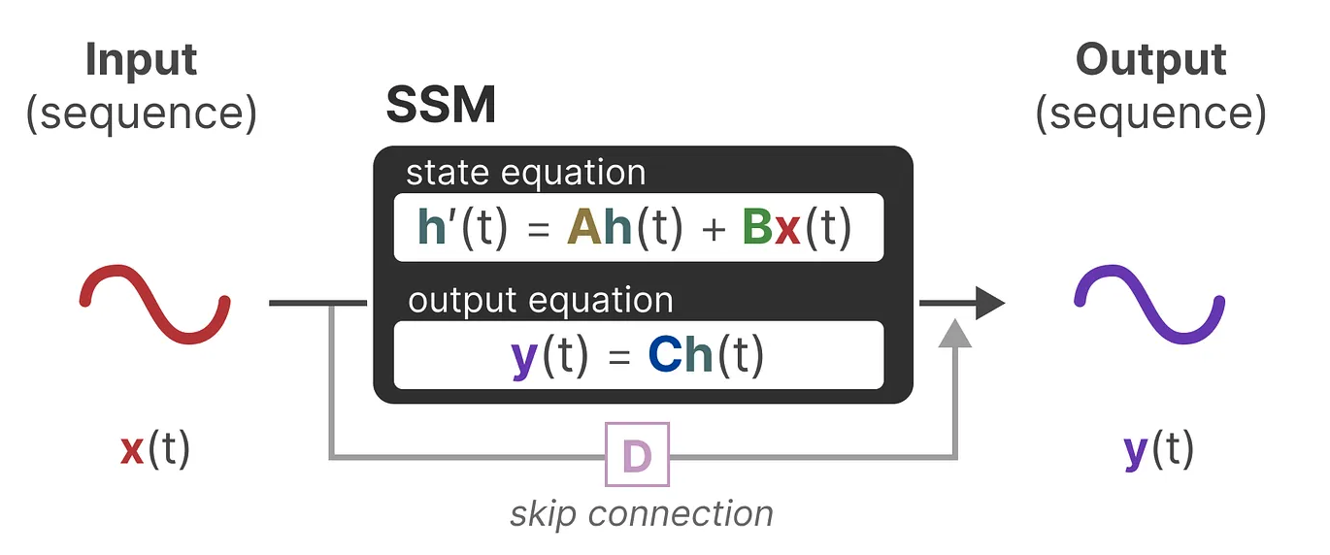
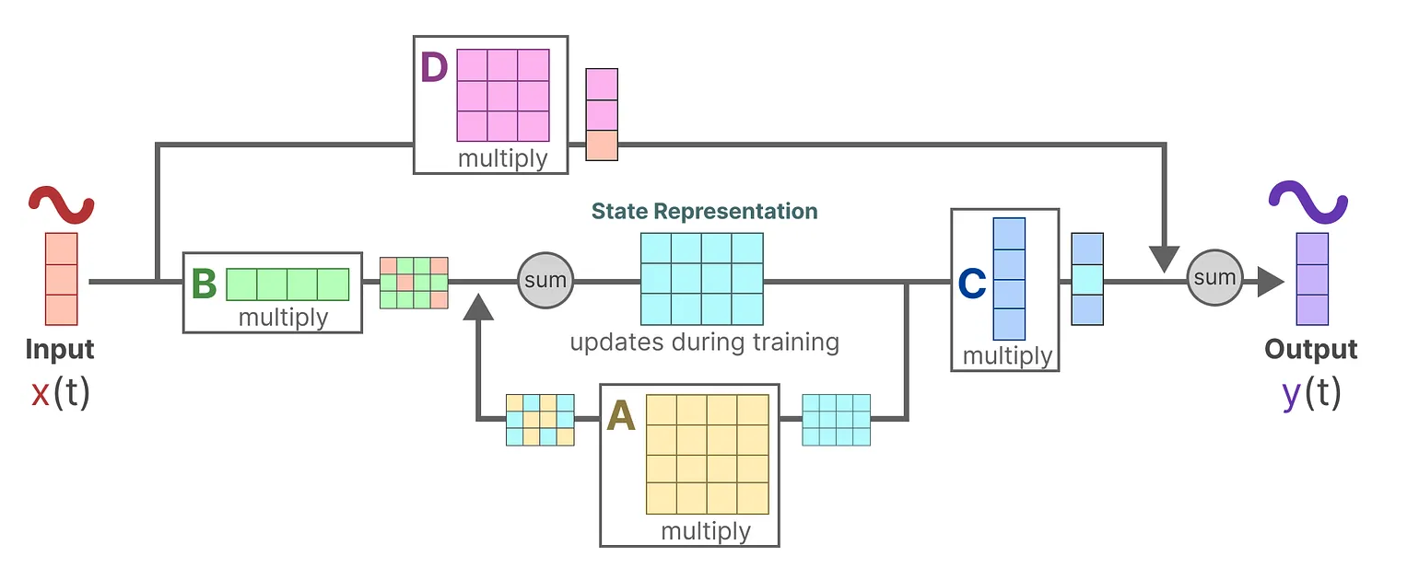
State Space Model (SSM)
Figures: https://newsletter.maartengrootendorst.com/p/a-visual-guide-to-mamba-and-state

Slide 8
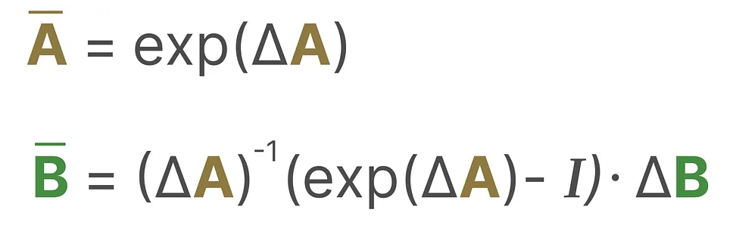
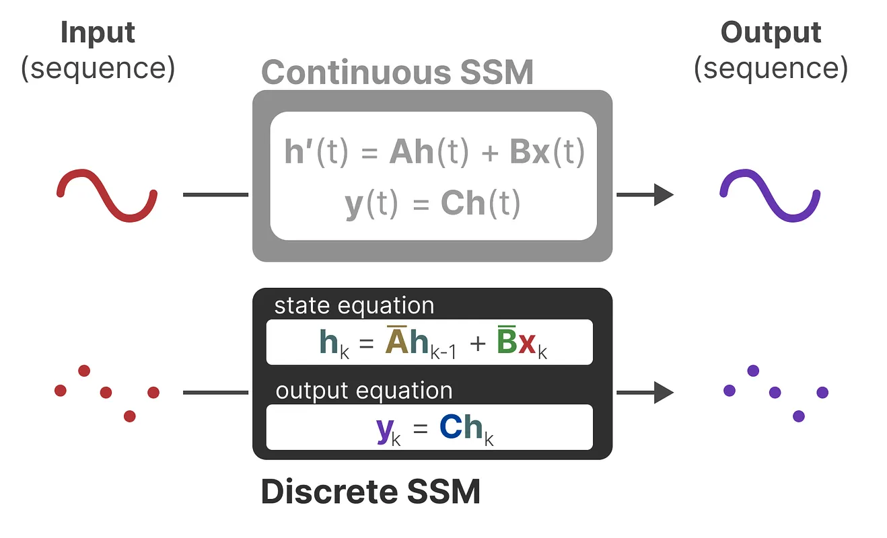
Discretization
Zero-order hold
Fast inference
Figures: https://newsletter.maartengrootendorst.com/p/a-visual-guide-to-mamba-and-state

Slide 9
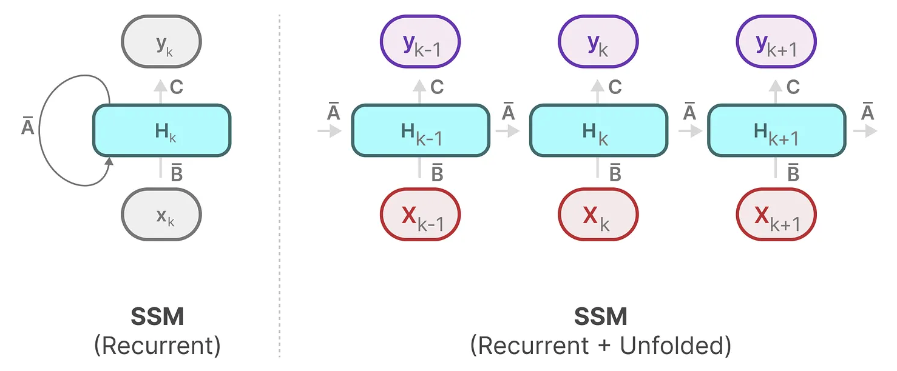
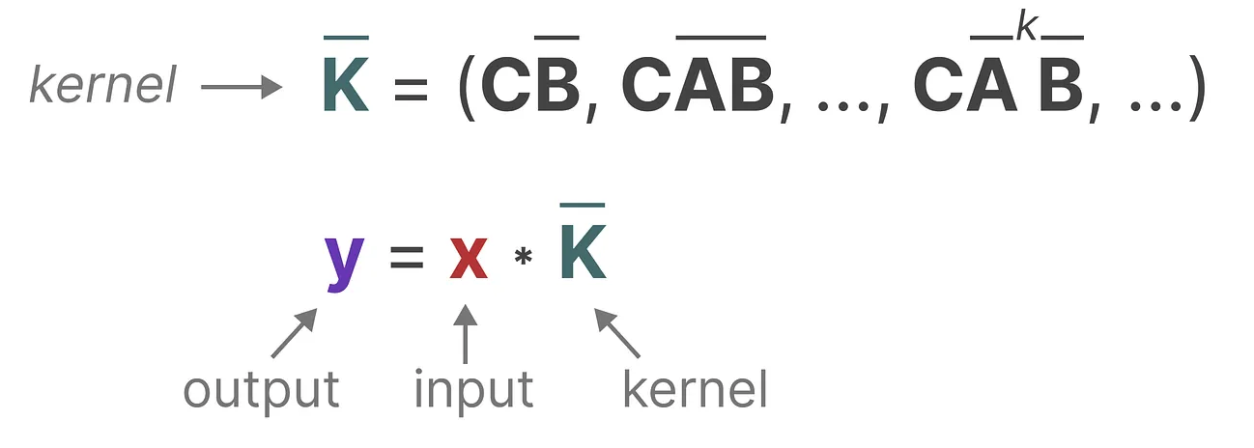
Convolution Acceleration
Figures: https://newsletter.maartengrootendorst.com/p/a-visual-guide-to-mamba-and-state

Slide 10
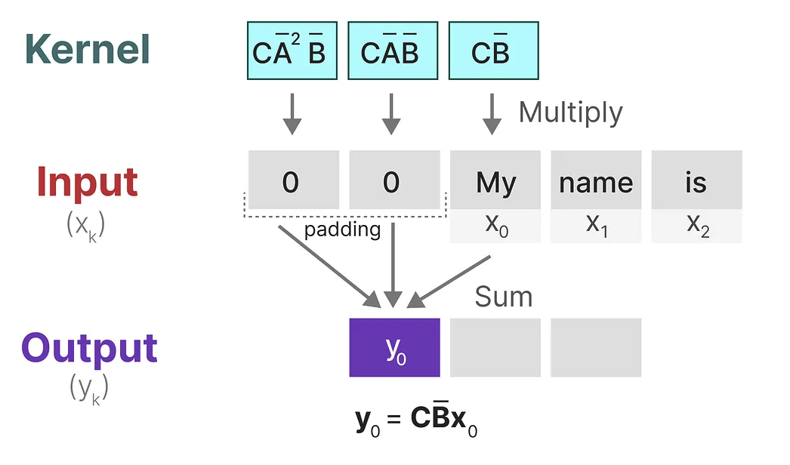
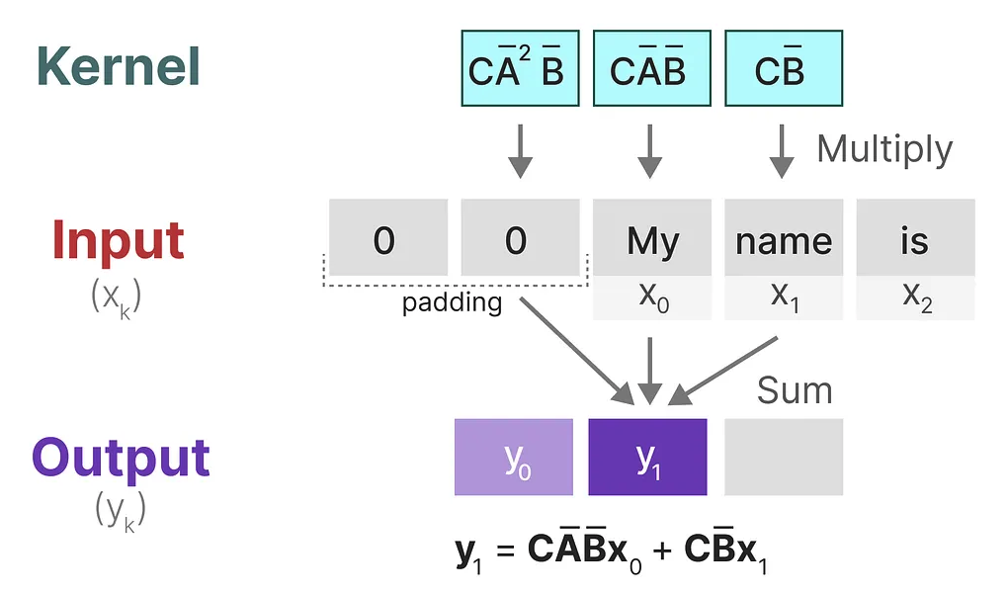
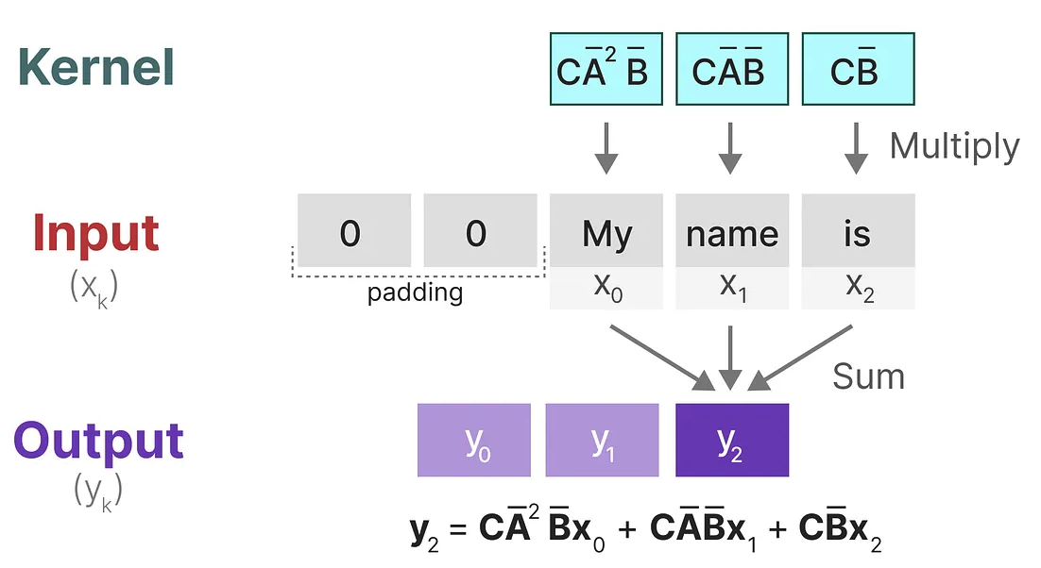
Convolution Acceleration
Fast training
Step 0
Step 1
Step 2
Figures: https://newsletter.maartengrootendorst.com/p/a-visual-guide-to-mamba-and-state

Slide 11
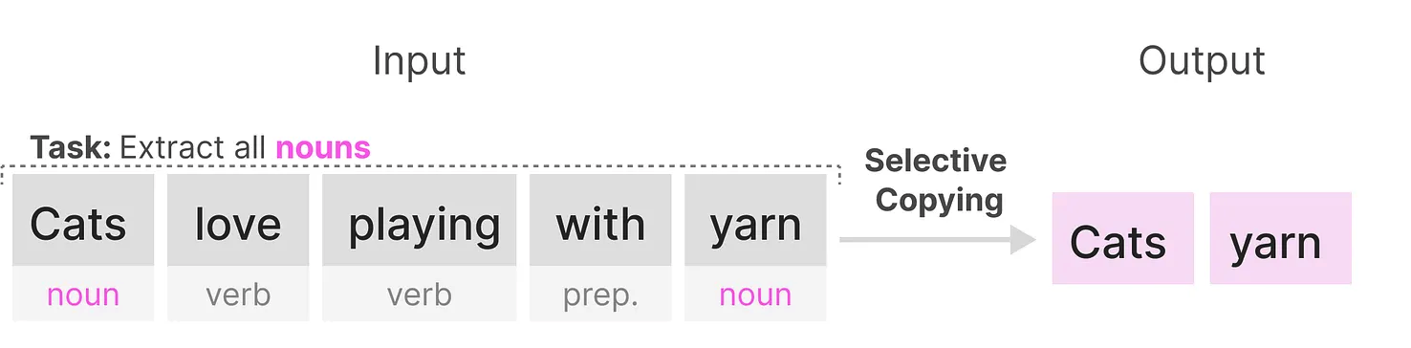
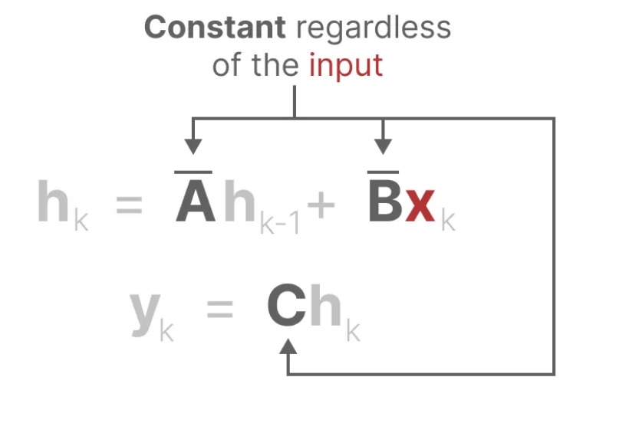
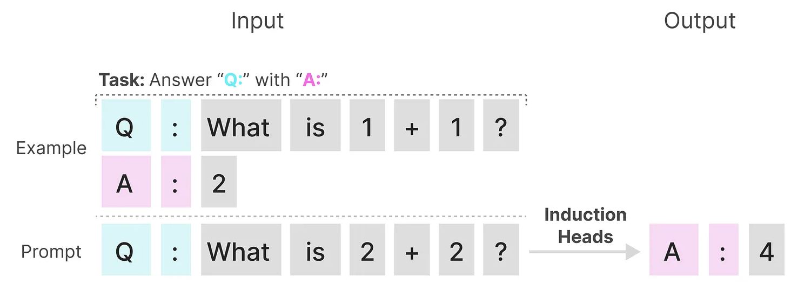
Problems with SSMs
Weak modelling efficacy
Selective copying
Induction head
Figures: https://newsletter.maartengrootendorst.com/p/a-visual-guide-to-mamba-and-state

Slide 12
Mamba
Model | Training | Inference | Memory | Modelling Efficacy
Transformers | Fast (parallelizable) | Slow (quadratically to sequence length) | Large (attention map scale to sequence length) | Strong
RNNs | Slow (Non parallelizable) | Fast (Constant) | Small (Constant) | Strong (LSTM)
SSMs | Fast (convolution) | Fast (Constant) | Small (Constant) | Weak (time-invariant)
Mamba | Fast (convolution) | Fast (Constant) | Small (Constant) | Strong (time-variant)
Make the system parameters input-dependent → Selection mechanism
Keep computation efficient → Hardware-aware algorithm

Slide 13
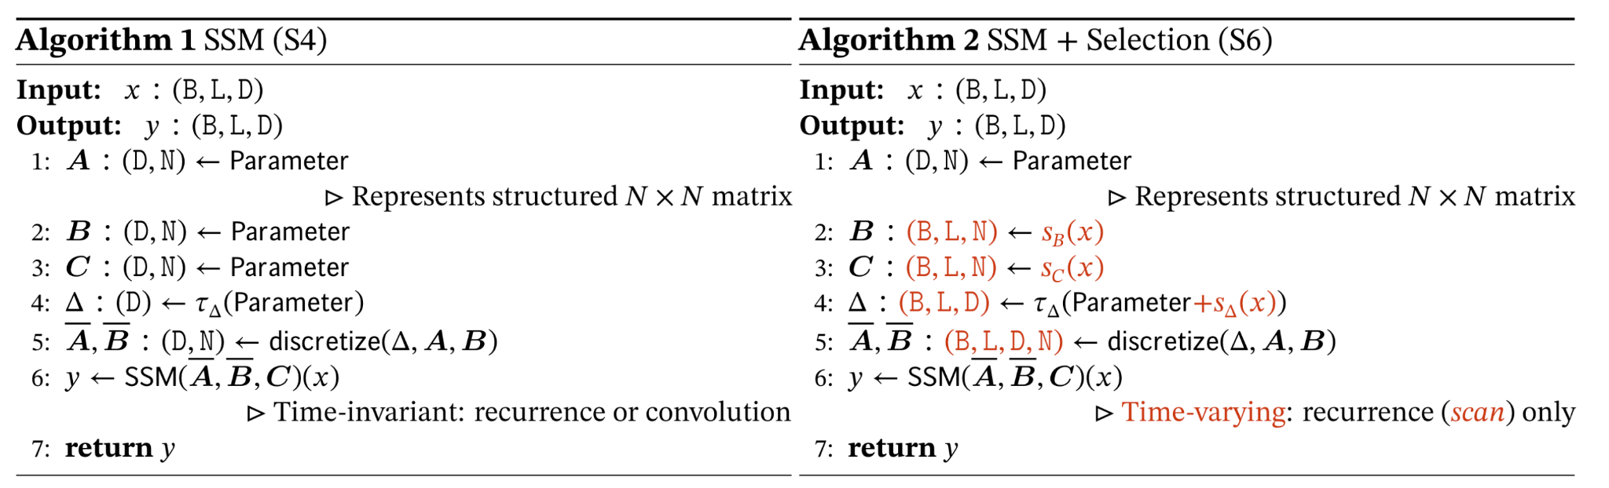
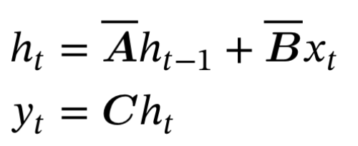
Selection Mechanism
Make Δ, B, C to be the functions of input
B: batch size
L: sequence length
D: input channel size
N: size of hidden state
Gu, Albert, and Tri Dao. “Mamba: Linear-Time Sequence Modeling with Selective State Spaces.” arXiv, December 1, 2023.

Slide 14
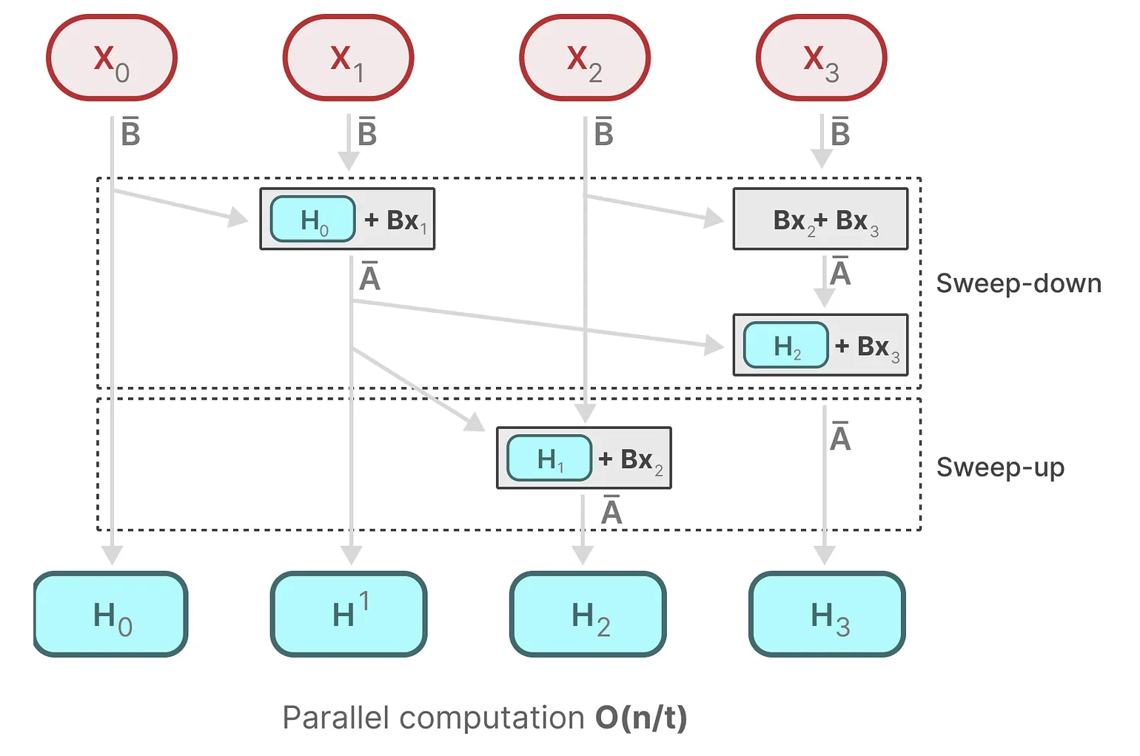
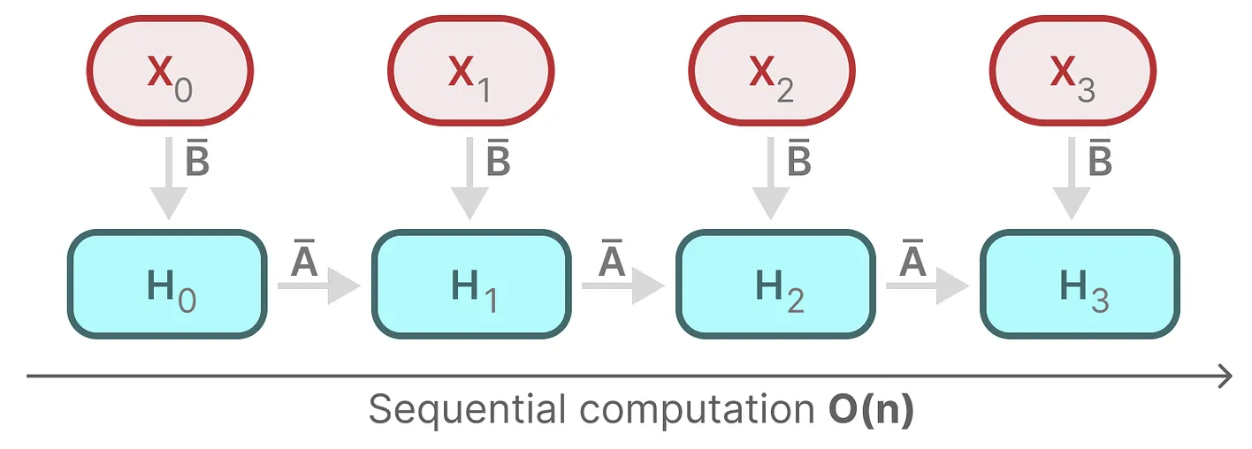
Hardware-aware Algorithm
Parallel scan
Recurrence
Mamba
Figures: https://newsletter.maartengrootendorst.com/p/a-visual-guide-to-mamba-and-state

Slide 15
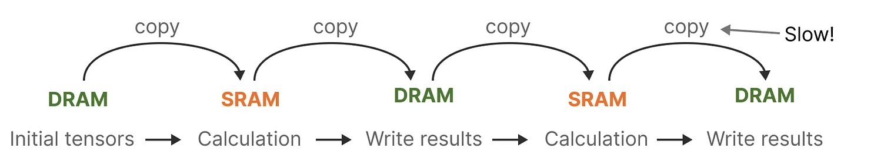
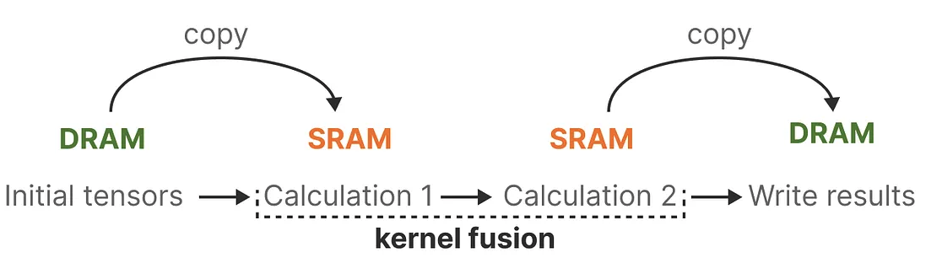
Hardware-aware Algorithm
Parallel scan
Kernel fusion
SRAM
Figures: https://newsletter.maartengrootendorst.com/p/a-visual-guide-to-mamba-and-state

Slide 16
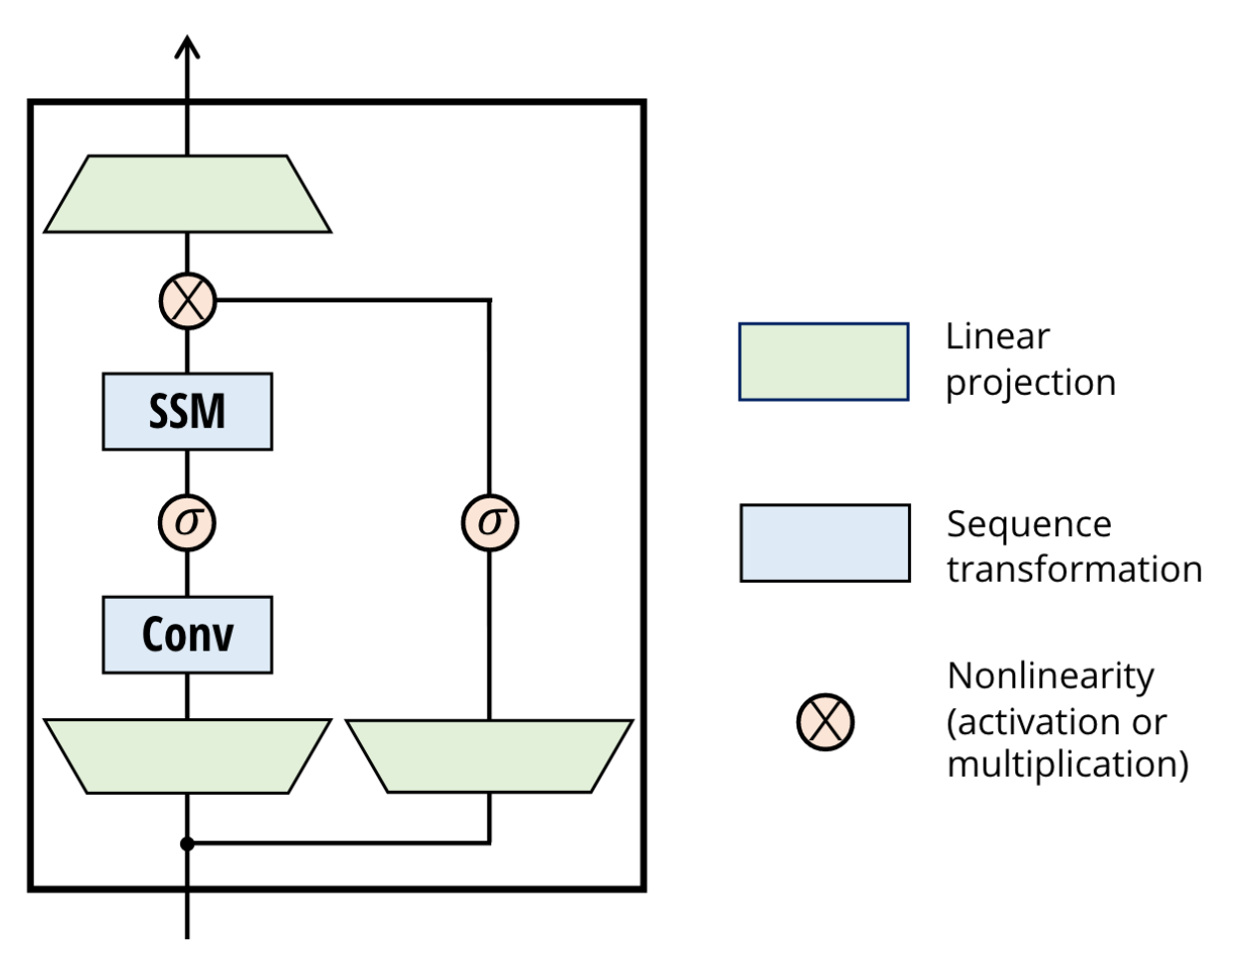
Hardware-aware Algorithm
Parallel scan
Kernel fusion
Recomputation
Do not save the intermediate states
Figures: https://newsletter.maartengrootendorst.com/p/a-visual-guide-to-mamba-and-state

Slide 17
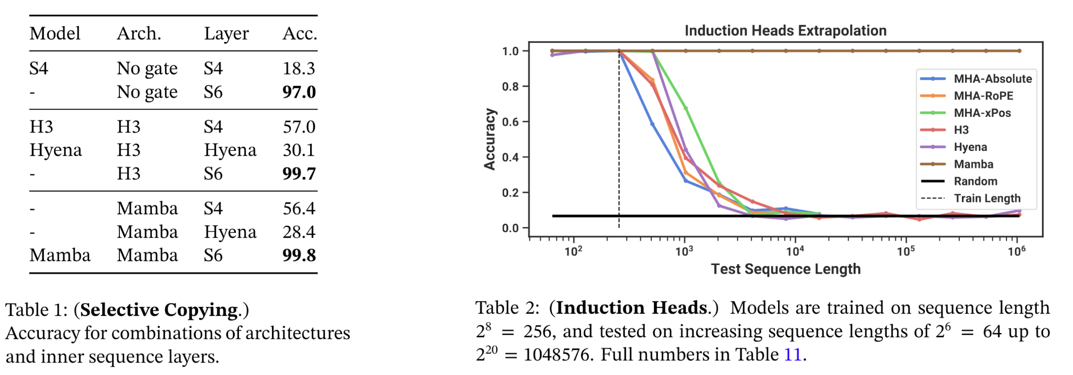
Mamba Performance
Significantly outperform transformers in the long sequence scenario

Slide 18
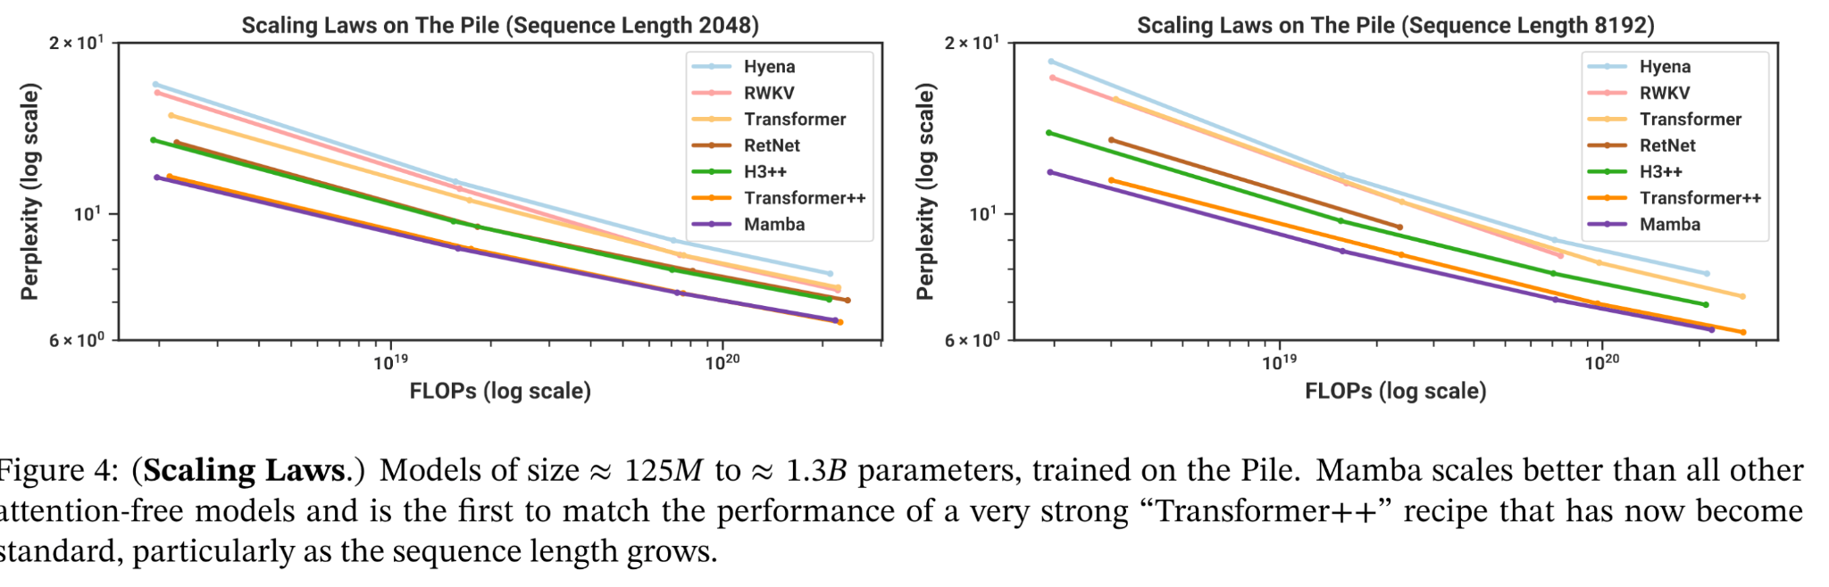
Mamba Performance
The first attention-free model to match the performance of a strong transformer

Slide 19
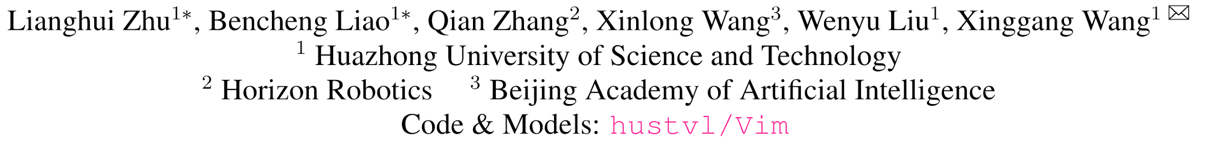
Vision Mamba
Vision Mamba: Efficient Visual Representation Learning with Bidirectional State Space Model
ICML 2024

Slide 20
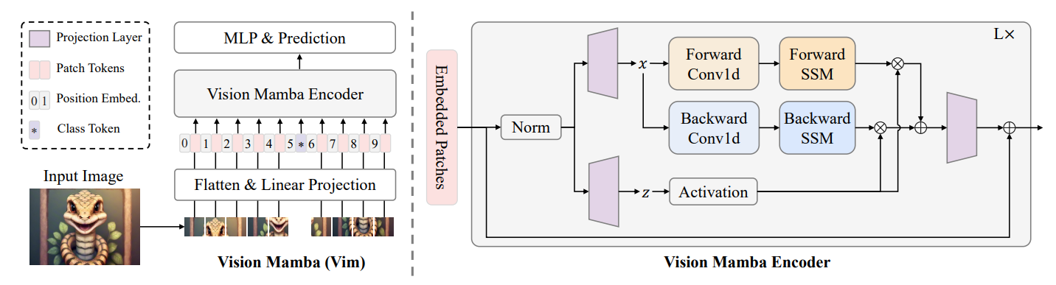
Vision Mamba: Architecture
Patches: Divide image into patches with positional embedding as in Transformer
Bidirectional: Gating mechanism (z) to select from two directions

Slide 21
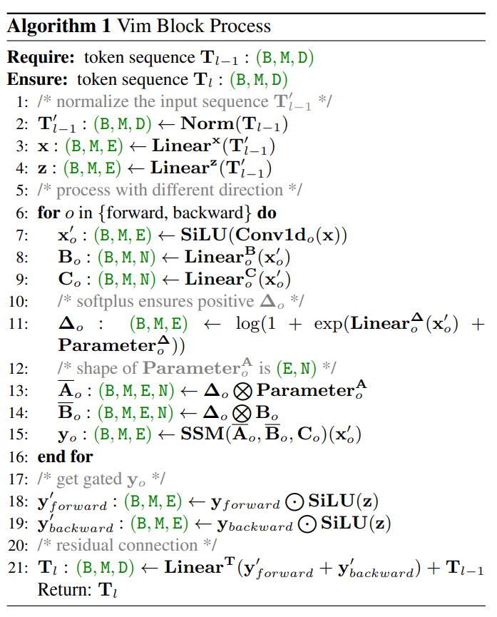
Vision Mamba: Vim block

Slide 22
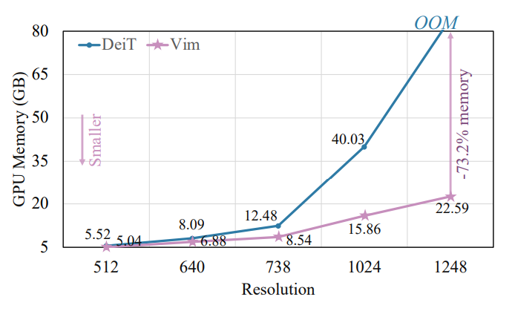
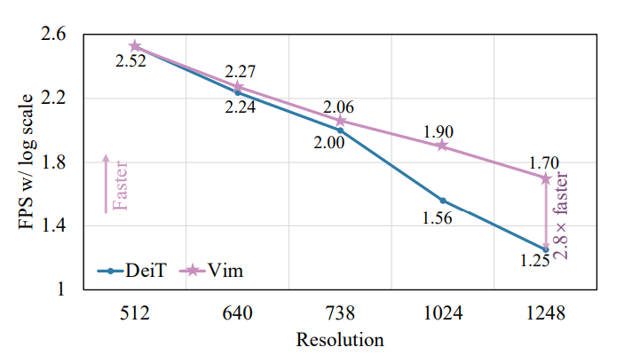
Vision Mamba: Efficiency
Memory & Speed

Slide 23
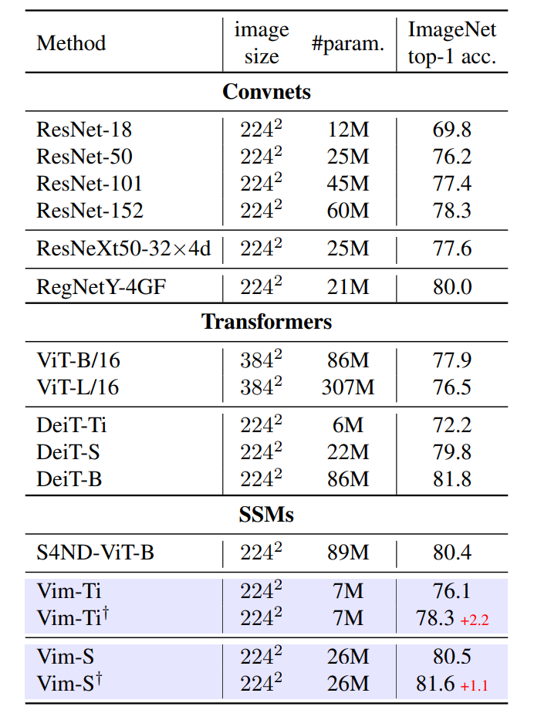
Vision Mamba: Image Classification

Slide 24
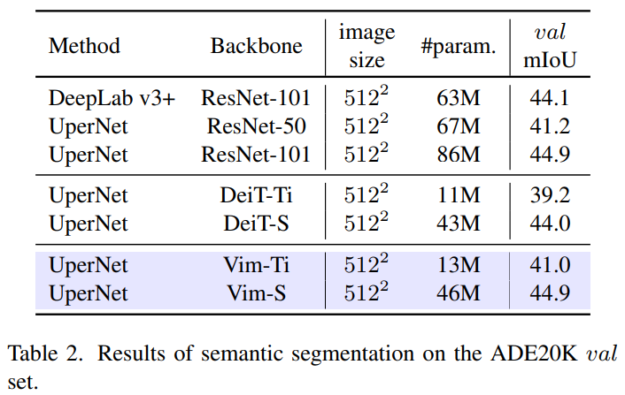
Vision Mamba: Semantic Segmentation

Slide 25
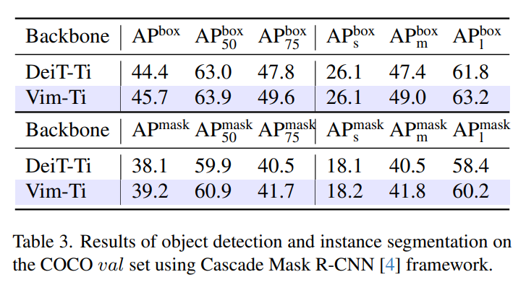
Vision Mamba: Object Detection & Instance Segmentation

Slide 26
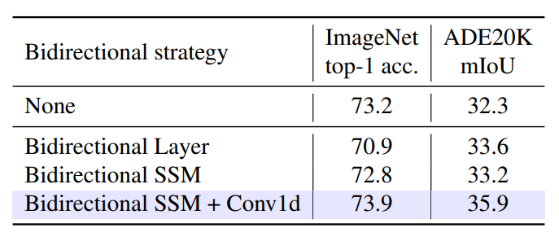
Vision Mamba: Ablation Study
None. We directly adopt the Mamba block to process visual sequence with only the forward direction.
Bidirectional Sequence. During training, we randomly flip the visual sequence. This works like data augmentation.
Bidirectional Block. We pair the stacked blocks. The first block of each pair processes visual sequence in the forward direction and the second block of each pair processes in the backward direction.
Bidirectional SSM. We add an extra SSM for each block to process the visual sequence in the backward direction.
Bidirectional SSM + Conv1d. Based on Bidirectional SSM, we further add a backward Conv1d before the backward SSM

Slide 27
Reference
[1] MAARTEN GROOTENDORST. “A Visual Guide to Mamba and State Space Models”. https://newsletter.maartengrootendorst.com/p/a-visual-guide-to-mamba-and-state.
[2] Umar Jamil. “Mamba and S4 Explained: Architecture, Parallel Scan, Kernel Fusion, Recurrent, Convolution”, Math. https://www.youtube.com/watch?v=8Q_tqwpTpVU.
[3] Gu, Albert, and Tri Dao. “Mamba: Linear-Time Sequence Modeling with Selective State Spaces.” arXiv, December 1, 2023.
[4] Zhu, Lianghui, Bencheng Liao, Qian Zhang, Xinlong Wang, Wenyu Liu, and Xinggang Wang. “Vision Mamba: Efficient Visual Representation Learning with Bidirectional State Space Model.” In ICML 2024.

Slide 28
Q & A

Slide 29
Backup

